Slide 1
Web Service
B.Ramasubramanian

Slide 2
Web Service
What are web service ?
While web sites are used by humans as end user.
Web services are consumed by applications.
It is used for application to application communication.
They are designed in such a way that applications run in different platform can communicate via web service.

Slide 3
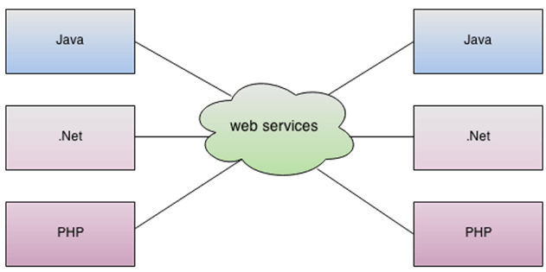
Web Service
As you can see in the figure, Java, .net, and PHP applications can communicate with other applications through web service over the network. So web service is a language independent way of communication.

Slide 4
Web Service
Types of Web Services
There are mainly two types of web services.
SOAP web services.
RESTful web services.

Slide 5
RESTful web services.
Architectural principles of REST
Addressable Resources
A house is identified by door number.
A resource is identified by URI
Well defined methods to interact with resource
GET-to retrieve a resource
PUT-to update a resource
DELETE-to delete a resource
POST-to create a resource

Slide 6
RESTful web services
Representation oriented
To describe the data format of input content type header is used. To describe the data format of output Accept type header is used.
Data formats
application/json
text/XML
application/XML
text/plain
Stateless
Services are implemented as stateless to improve the scalability

Slide 7
RESTful web services
Resource Modeling
Rules for naming resources
Use simple word nouns that are pluralized.
Examples: students, customers, employees.
Use lower case with hyphen to separate words, but try to use single word.

Slide 8
RESTful web services
Resource | POST | GET | PUT | DELETE
/students | Create a new student | Retrieve a list of students
/students/studentid |  | Retrieve a student | Update a student | Delete a student

Slide 9
RESTful web services
Method specific annotation definitions: Get All
@GetMapping
Get specific resource
@GetMapping("/{id}")
Create resource
@PostMapping
NOTE: Payload data should be sent in the body of the request Update resource
@PutMapping
NOTE: Payload data should be sent in the body of the request Delete resource
@DeleteMapping("/{id}")

Slide 10
RESTful web services
JAX-RS
JAX-RS stands for JAVA API for RESTful Web Services. JAX-RS is a JAVA based programming language API and specification to provide support for created RESTful Web Services.

Slide 11
RESTful web services
Jersey RESTful Web Services framework is open source, production quality, framework for developing RESTful Web Services in Java that provides support for JAX-RS APIs and serves as a JAX-RS (JSR 311 & JSR 339) Reference Implementation.

